Slide 1
Context-Aware Layout to Image Generation with Enhanced Object Appearance
Sen He, Wentong Liao, Michael Ying Yang, Yongxin Yang,
Yi-Zhe Song, Bodo Rosenhahn, Tao Xiang
Code: https://github.com/wtliao/layout2img

Slide 2
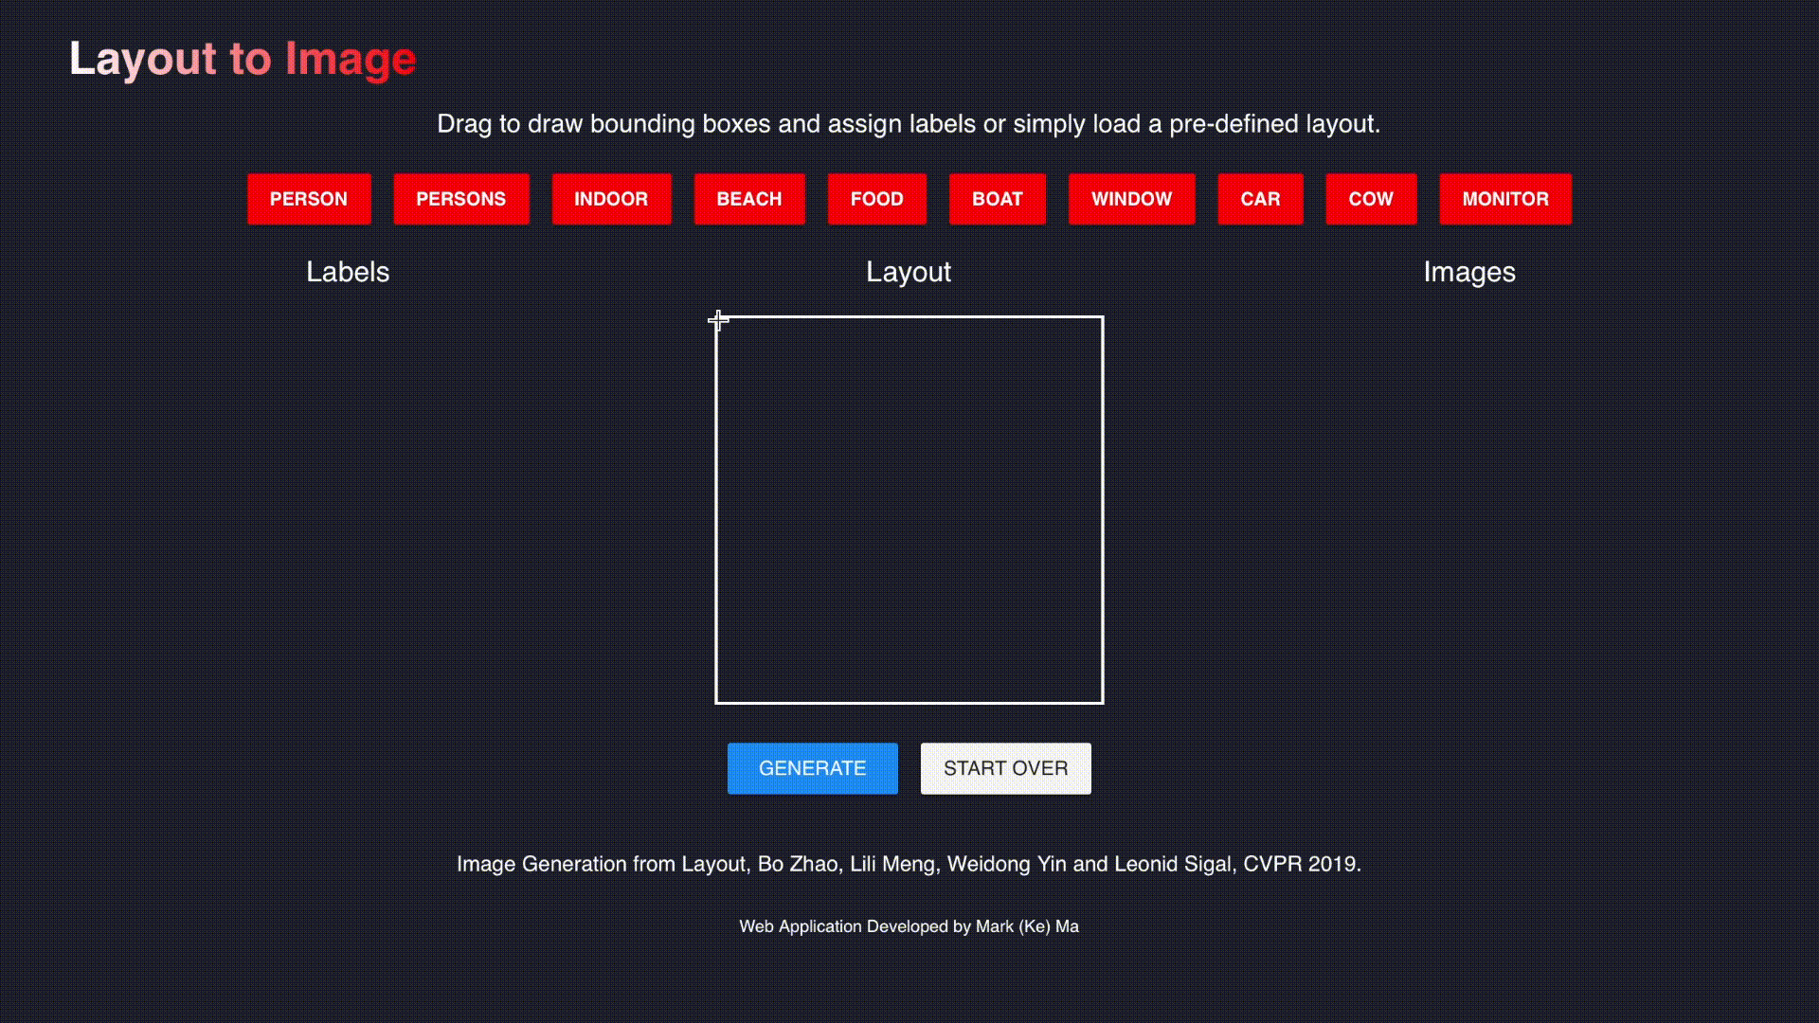
Applications
Flexible input format, convenient interactive creation
Demo from: https://github.com/zhaobozb/layout2im

Slide 3
Applications
Benefit other conditional image generation tasks
Layout prediction
Layout prediction
A good layout to image generation model is all you need !

Slide 4
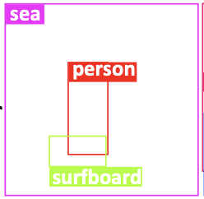
Challenges of layout to image generation
Challenges of layout to image generation
Context – respect other regions

Slide 5
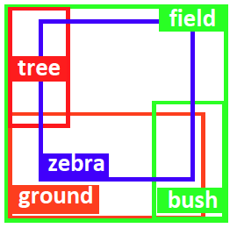
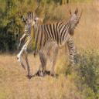
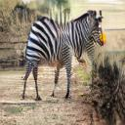
Challenges of layout to image generation
Appearance – location sensitive
D
D
Zebra
Zebra

Slide 6
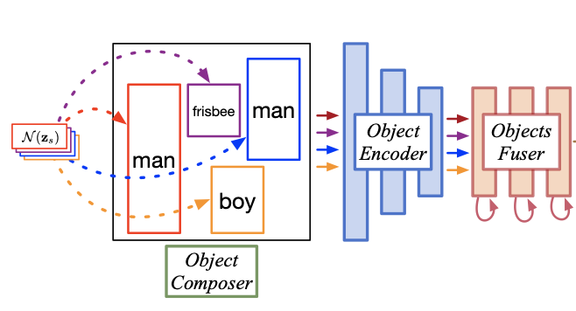
Existing methods and limitations
Current layout to image generator
G
constant
G
Feature for each box generated independently
No explicit modelling about the context !

Slide 7
Existing methods and limitations
Current layout to image discriminator
Global pooling
Real or Fake
Image level
D
ROI pooling
Real or Fake
Region level
Classification based discriminator
No location sensitive appearance penalty !

Slide 8
Our method
Generated
$$ℒ_{im}$$
Initially generated feature vector
Context transformed feature vector
$$z∈N(0, 1)$$
Generator
Discriminator
ROI aligned feature map
$$ℒ_{o}$$
Gram Matrix
Appearance discrimination
Input layout
Context transformation
feature map
bowl
, b₁
bowl
bowl
, b₂
ROI Align
Gram Matrices
Feature generation
bowl
, b₃
, b₄
$$𝒜$$
$$ℒ_{a}$$
Context-Aware Layout to Image Generation with Enhanced Object Appearance

Slide 9
Our method – Context modelling
Initially generated feature vector
Context transformed feature vector
Input layout
bowl
bowl
bowl
Feature generation
bowl

Slide 10
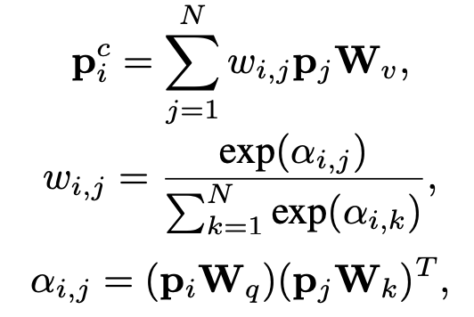
Our method – Context modelling
Initially generated feature vector
Context transformed feature vector
Input layout
Context transformation
bowl
bowl
bowl
Feature generation
bowl

Slide 11
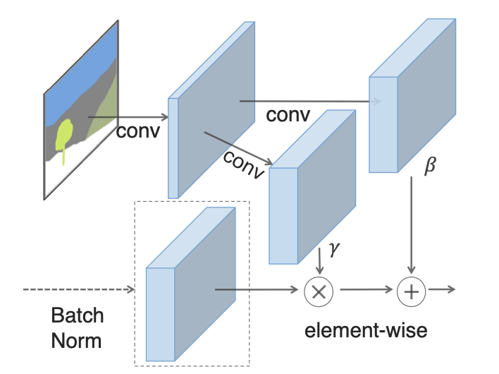
Our method – Context modelling
Generated
Initially generated feature vector
Context transformed feature vector
$$z∈N(0, 1)$$
Generator
Input layout
Context transformation
GauGAN, CVPR 2019
, b₁
bowl
bowl
, b₂
bowl
Feature generation
, b₃
bowl
, b₄

Slide 12
Our method – Appearance discrimination
ROI aligned feature map
Gram Matrix
Generated
Appearance discrimination
Discriminator
feature map
ROI Align
Gram Matrices
$$𝒜$$
$$ℒ_{a}$$
Position sensitive,
texture related
Neural style transfer, Neurips 2015

Slide 13
Our method
Generated
$$ℒ_{im}$$
Initially generated feature vector
Context transformed feature vector
$$z∈N(0, 1)$$
Generator
Discriminator
ROI aligned feature map
$$ℒ_{o}$$
Gram Matrix
Appearance discrimination
Input layout
Context transformation
feature map
bowl
, b₁
bowl
bowl
, b₂
ROI Align
Gram Matrices
Feature generation
bowl
, b₃
, b₄
$$𝒜$$
$$ℒ_{a}$$

Slide 14
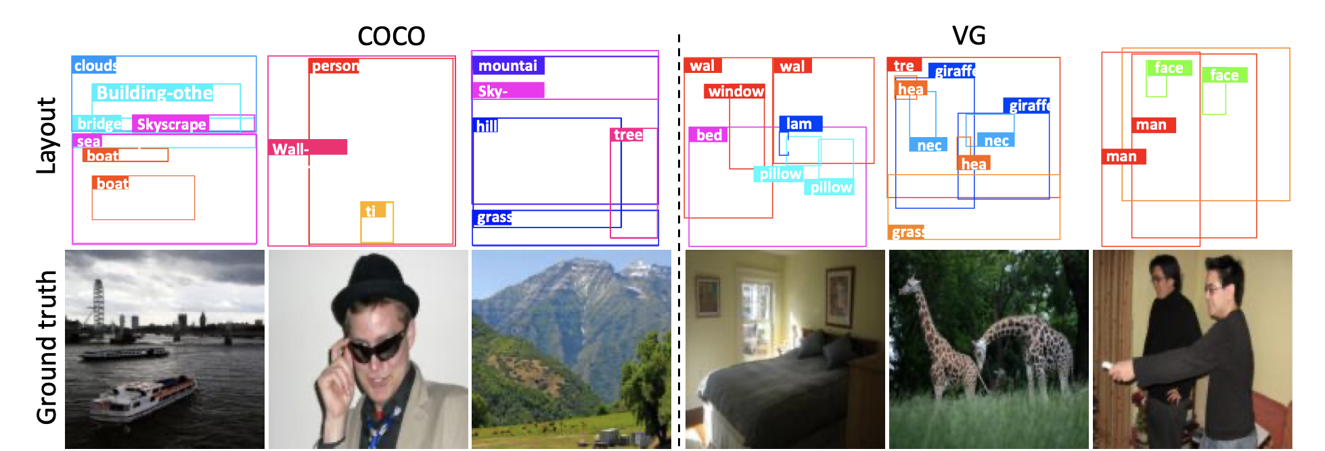
Benchmarks
MSCOCO 171 classes
Visual Genome
178 classes

Slide 15
Results

Slide 16
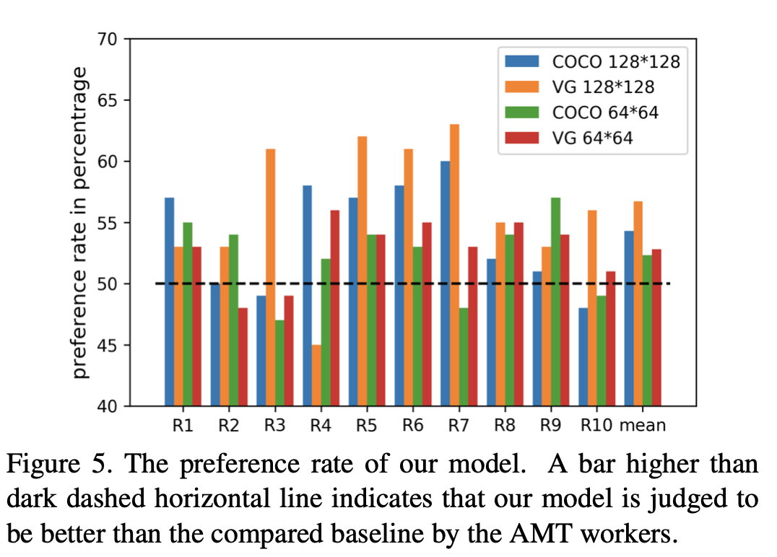
Results

Slide 17
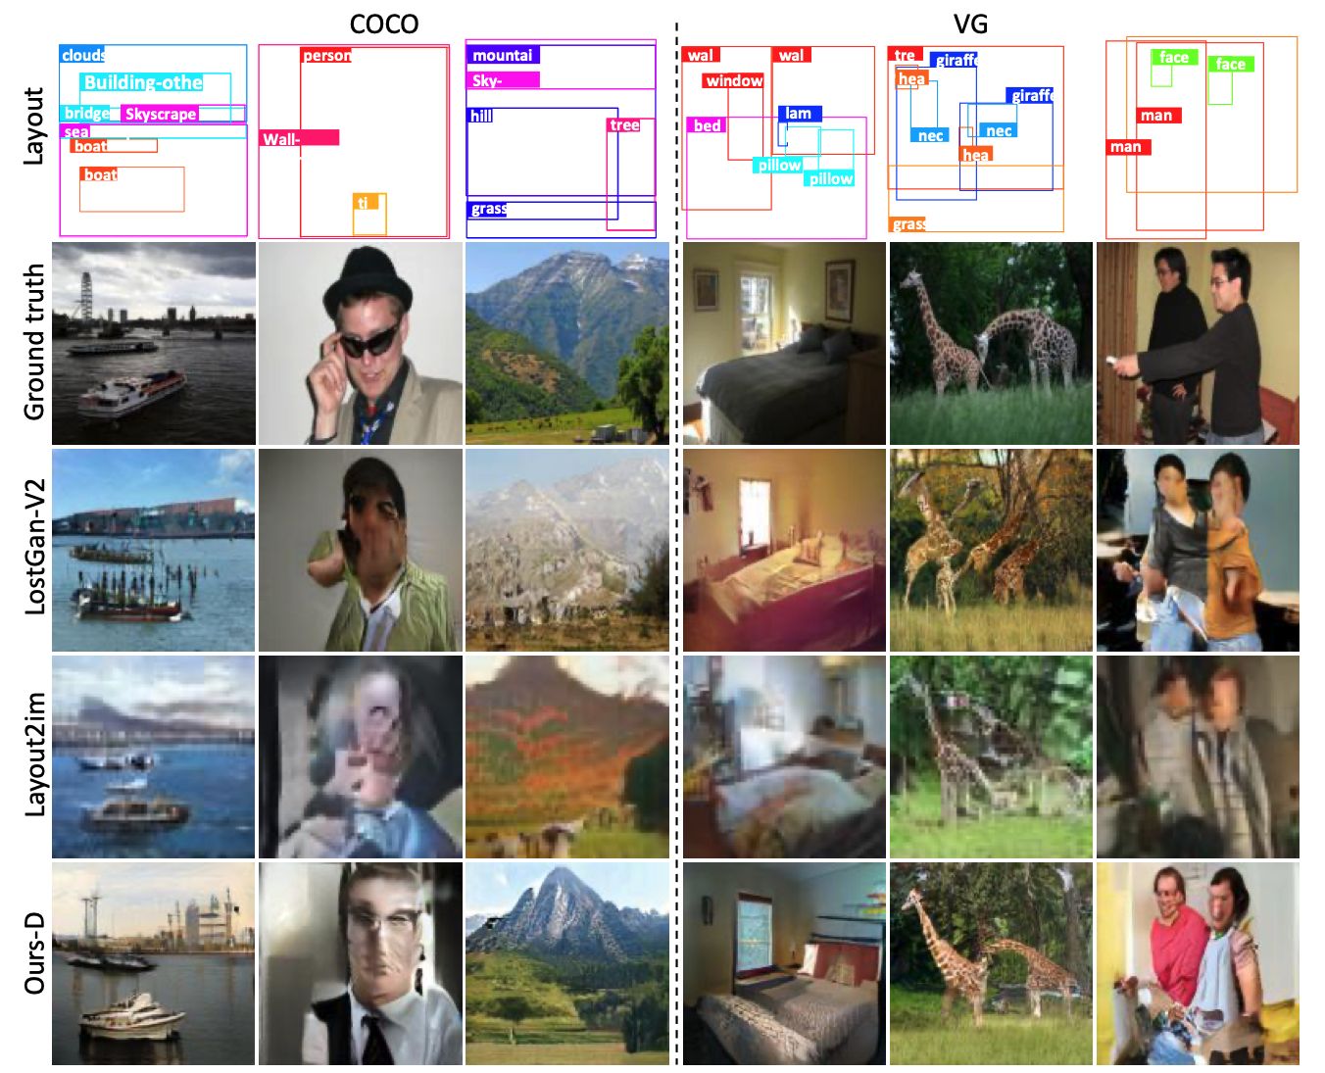
Results

Slide 18
Ablation Study

Slide 19
Conclusion
A context transformation module for feature contextualization in layout to image generation
An appearance penalty in the discriminator to enhance the appearance of the synthesized objects
State-of-the-art performance on MSCOCO and Visual Genome

